Slide 1






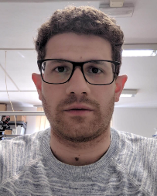


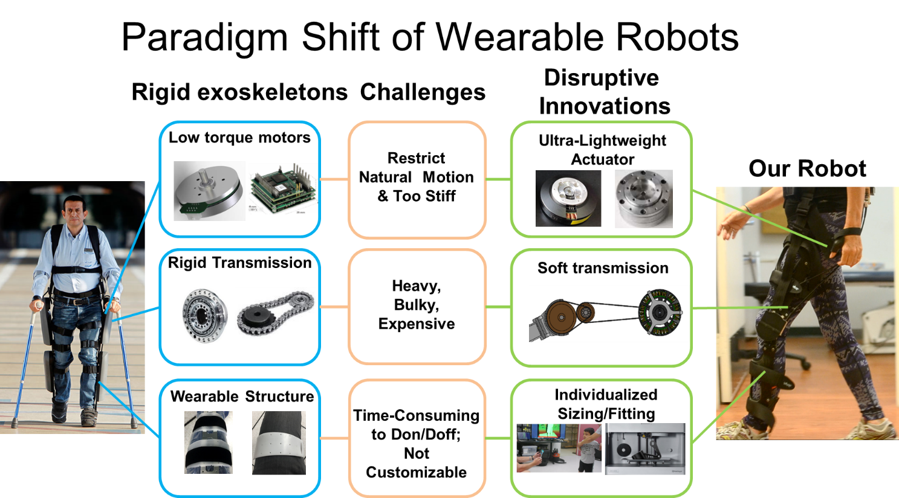
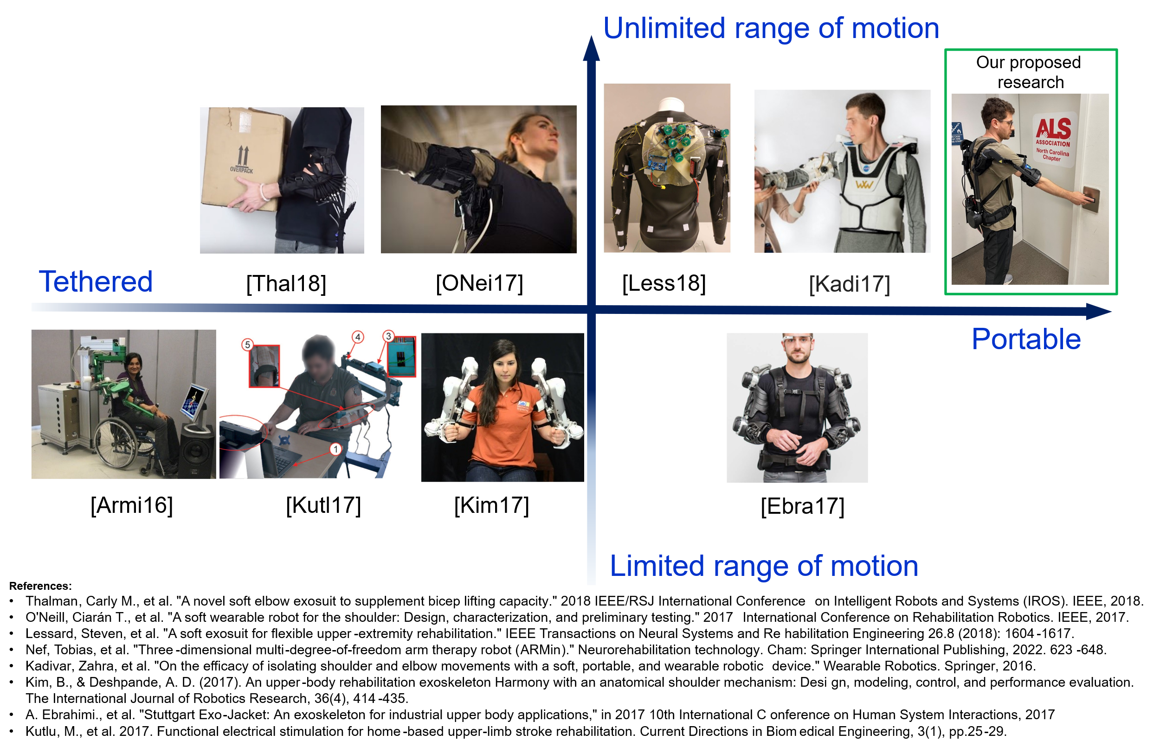
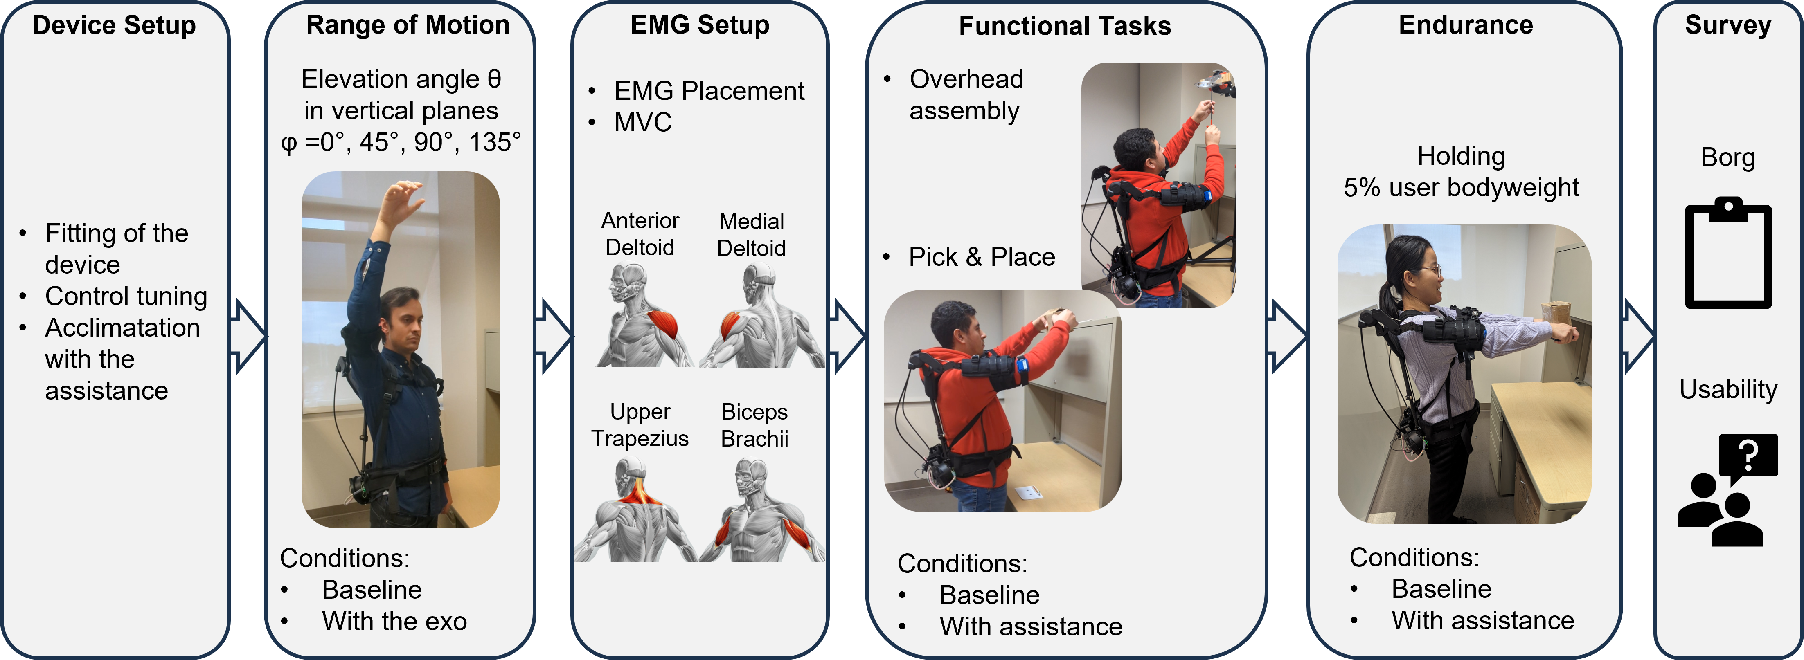
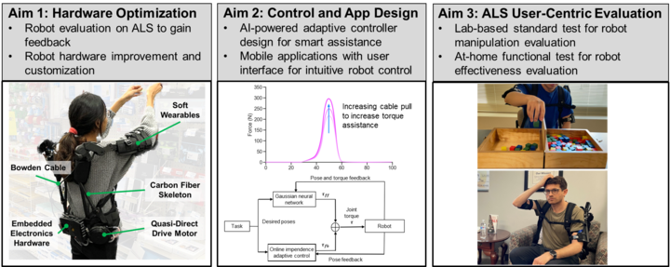
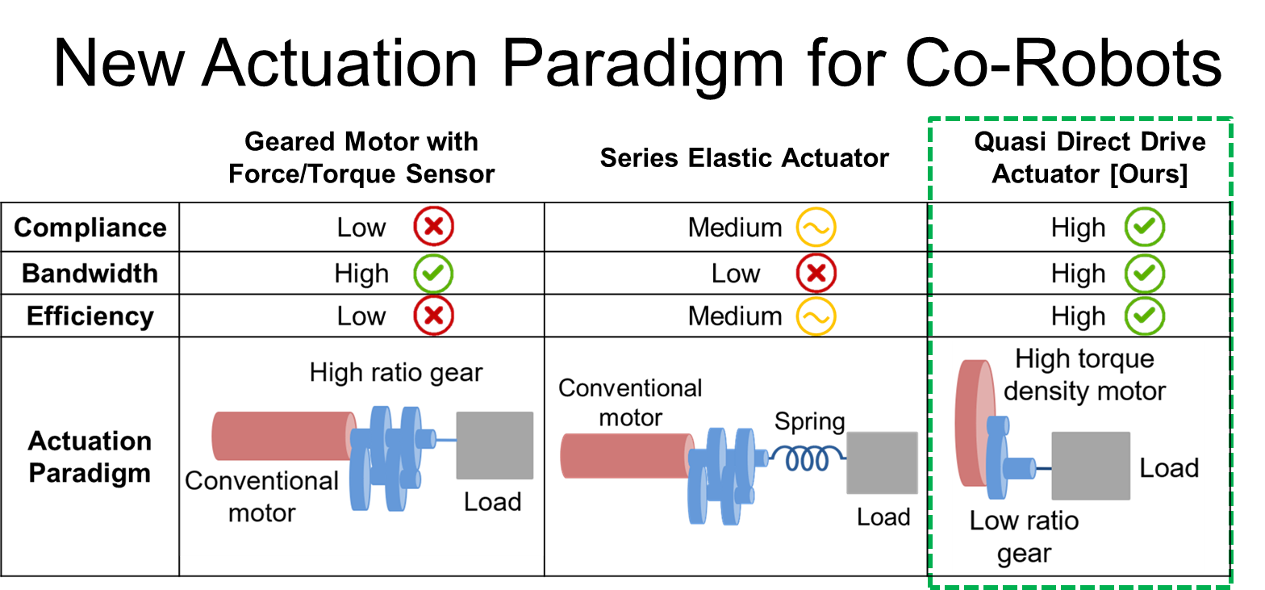
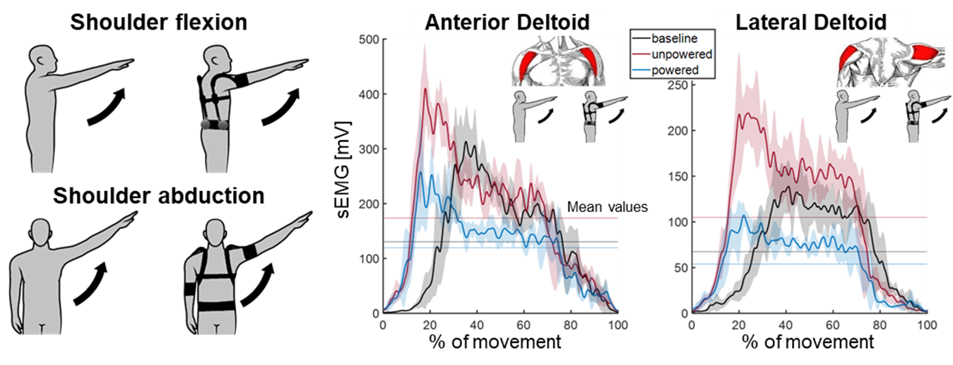
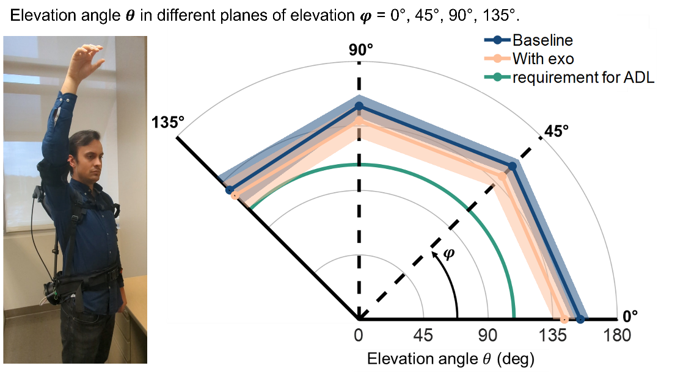
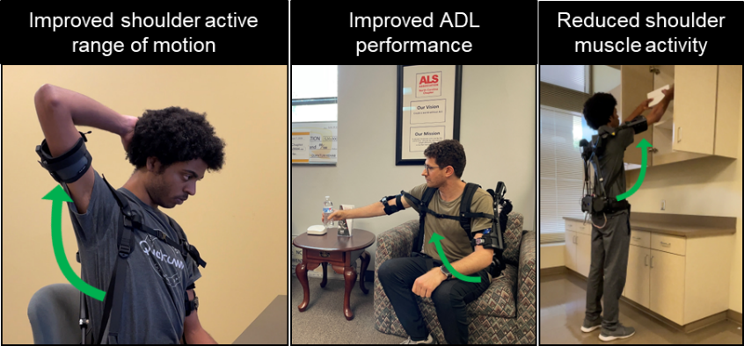
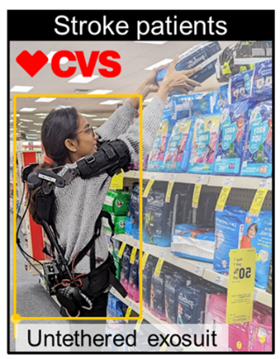
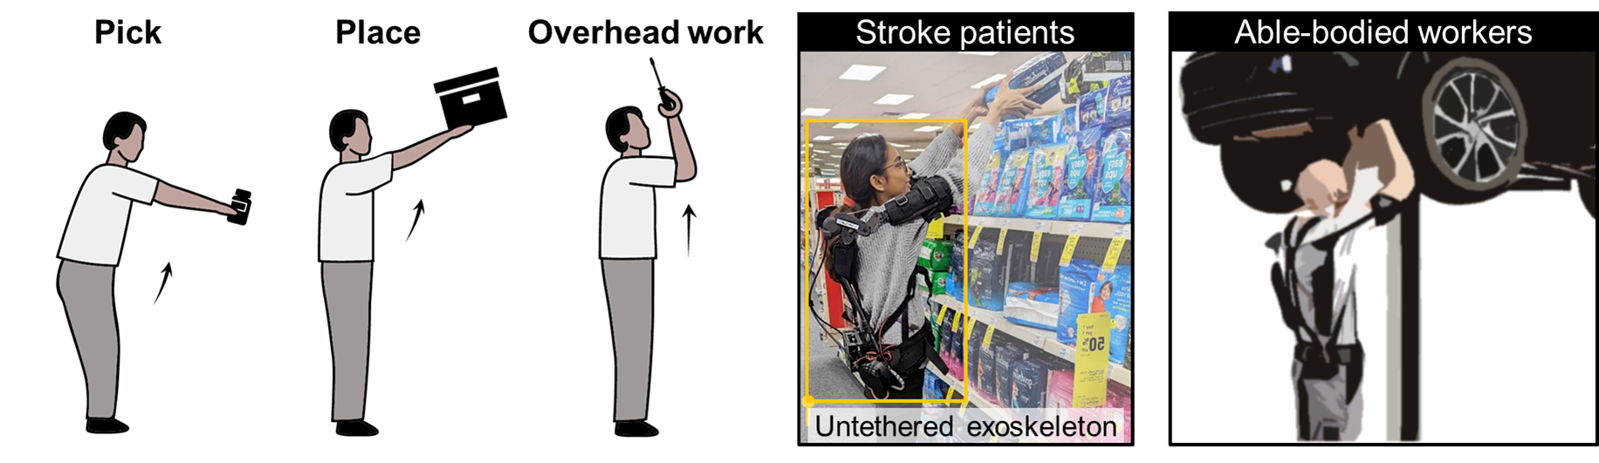
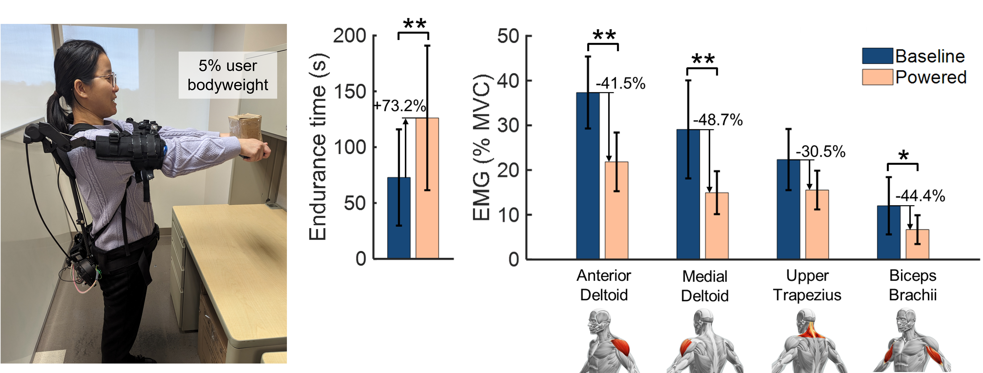
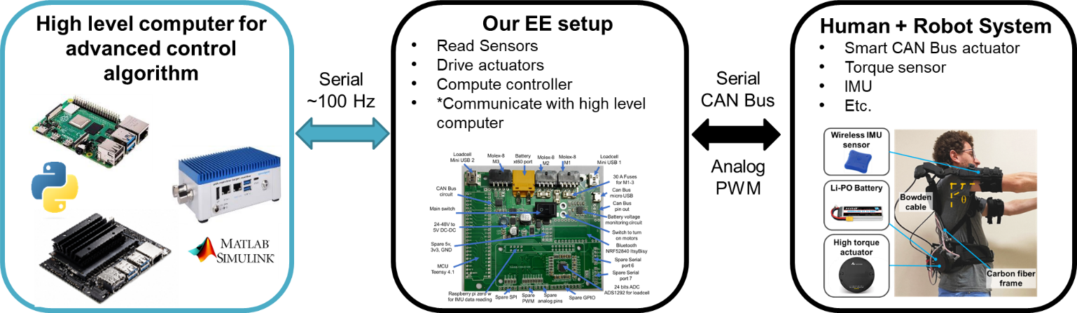
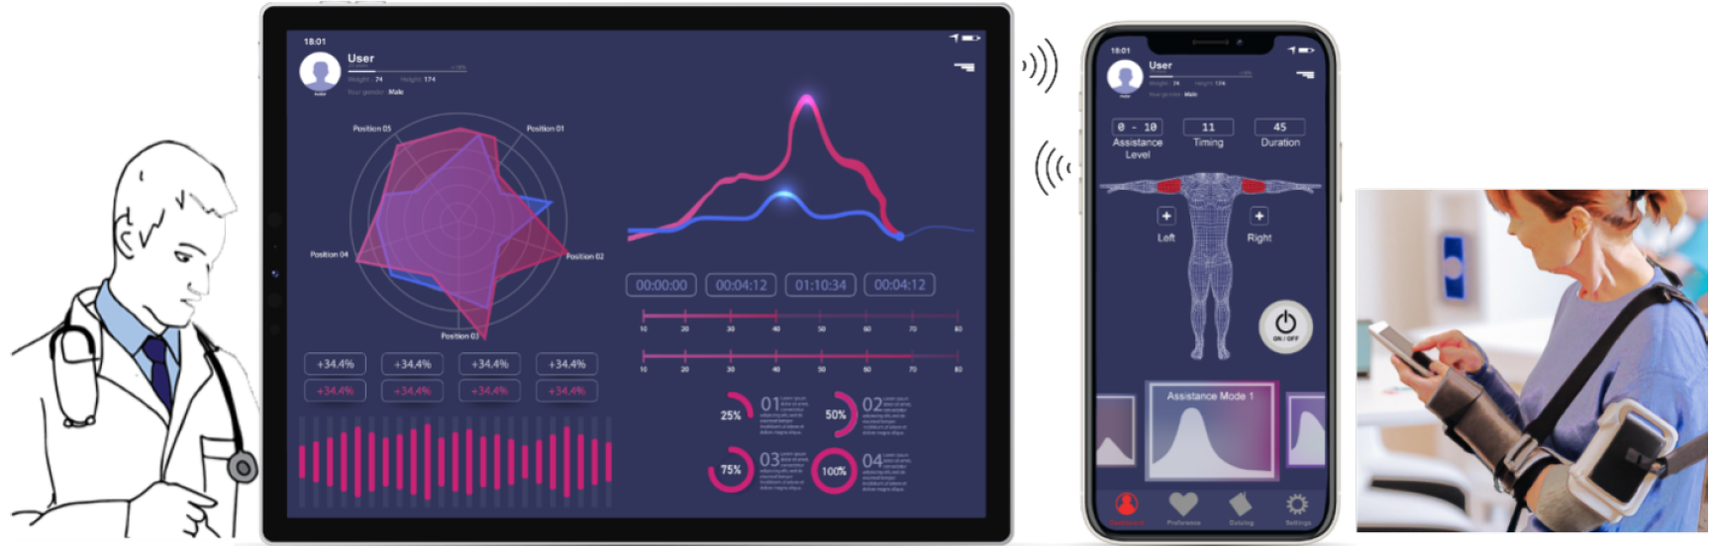
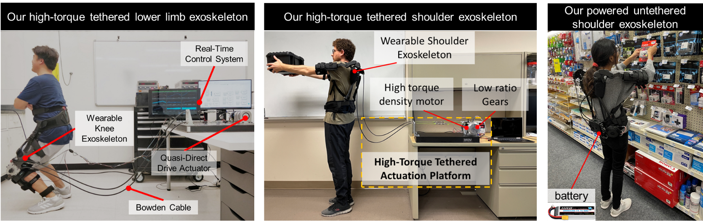
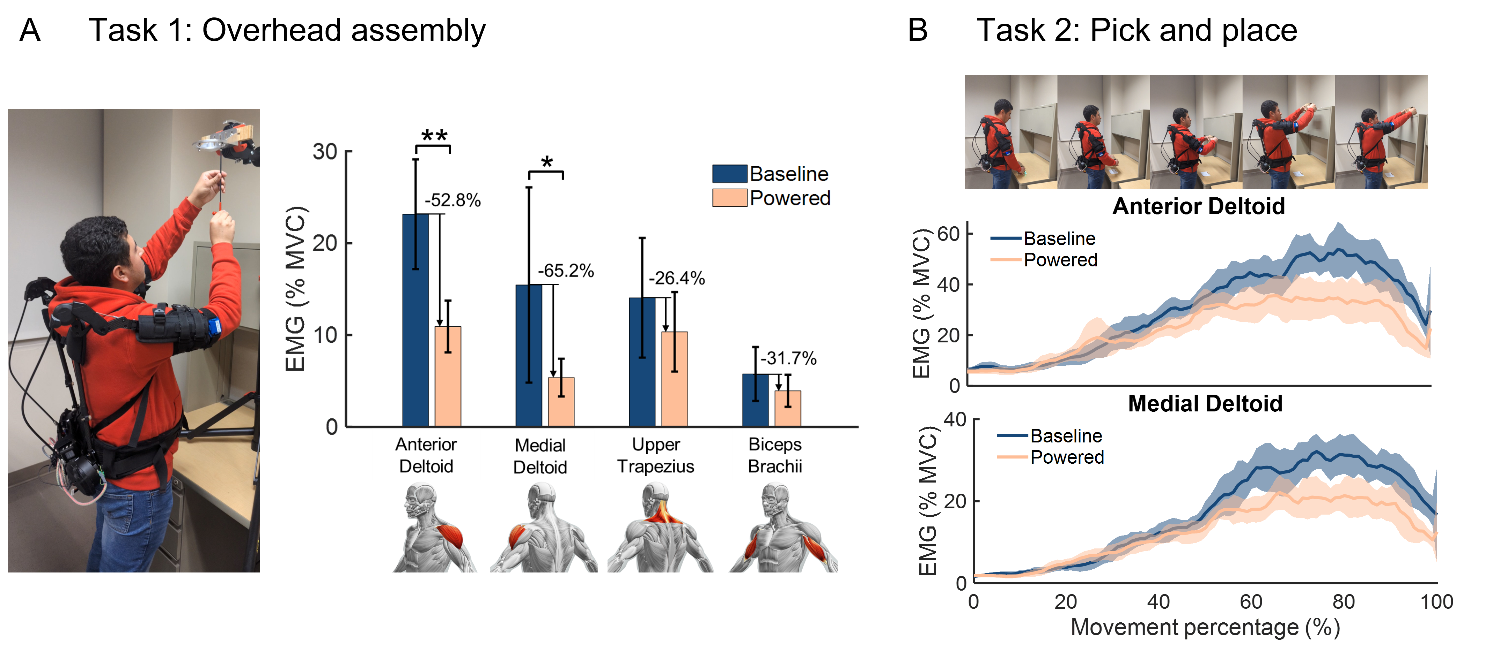
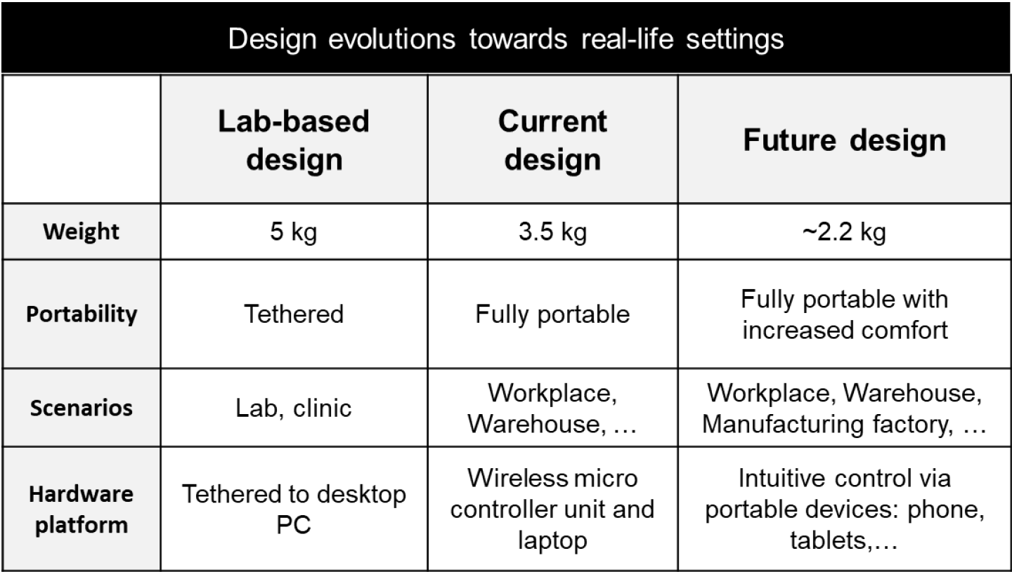
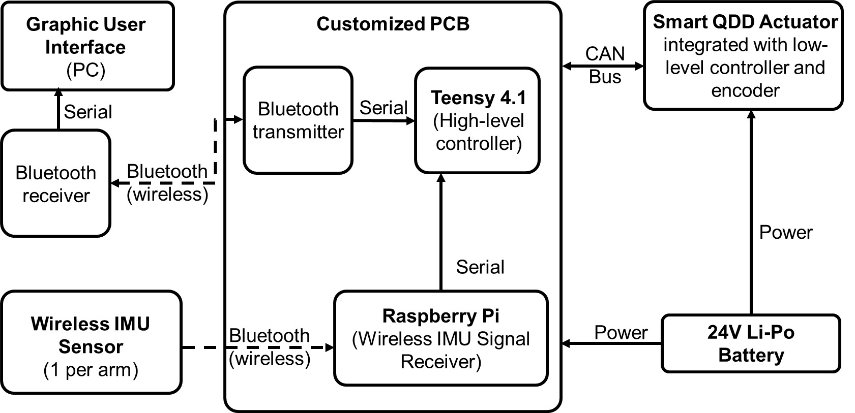

Soft Exosuit for Shoulder Assistance Toward
Individuals with Amyotrophic Lateral Sclerosis
Weibo Gao¹, Juncheng Zhou², Antonio Di Lallo², Hao Su^{1∗}
Website: http://haosu-robotics.github.io
¹Biomechatronics and Intelligent Robotics lab, Biomedical Engineering Department, Tandon School of Engineering, New York University, Brooklyn, NY, 11201, USA, ²Department of Mechanical and Aerospace Engineering, North Carolina State North Carolina State University, Raleigh, NC, 27695;
Weibo
Gao
Juncheng
Zhou
Antonio Di
Lallo
Hao Su
Project Overview
Soft Exoskeleton Innovations
Preliminary Results
Transition to Practice
The goal of this project is to accelerate the development and translation of modular portable soft exosuits (powered orthosis) for ALS individuals with residual movements and investigate their efficacy in restoring physical functions in clinic and home settings.
Preliminary results indicate the potential of our robot to assist in daily functional movements.
Study Protocol
The robot can assist both shoulder flexion, and abduction.
Despite the advances in assistive technologies, it is unclear whether upper-limb wearable robots can be truly useful in real-life workplaces.
To this end, we will conduct in-field tests with our exoskeleton in both retail stores (with stroke survivors), warehouses (with able-bodied workers), at home (with ALS individuals) to establish the facilitate transitions to reality
Upper Limb Exoskeleton Systems
Current portable shoulder exoskeletons, often passive and spring-based, prioritize lighter designs at the expense of adaptability and smart human-centered control. Conversely, powered devices, suitable for clinical rehabilitation, are typically bulky and tethered, limiting their applicability in daily activities.
To overcome these limitations, we developed the most lightweight, portable, powered shoulder exoskeleton.
Our wearable robot provides high torque assistance for 2 DoF human shoulder joint movements (flexion/extension, abduction/adduction) for heterogeneous users with different levels of impairments.
Our customized exoskeleton actuator is mounted on the back waist to minimize weight penalty caused by loads on distal body parts.
Portable and Expandable Electronics Architecture
Wearing the exoskeleton resulted in a slight reduction of the range of motion compared with the baseline condition (not wearing the device), but it did not compromise the possibility of performing most activities of daily living.
We proposed a powerful electronics architecture using a hierarchical structure with a high-level computer and a low-level microcontroller.
We will develop an application that can be utilized on tablets and cell phones with a graphic interface including an expert panel for analysis and remote control, and a user panel for intuitive control.
System Control Architecture
Lightweight and portable shoulder exoskeleton
It computes complex algorithms and improves the accuracy, speed, and efficiency of the exoskeleton’s control system, leading to better performance, user experience, and safety.
Our customized high-torque density motor and compact customized electronics maximize the portability and can handle AI computation workloads with various interfaces for multi-sensor infusion.
The average endurance time increased from 73 s to 126 s (+73.2%) with assistance compared to not wearing the device. This result is supported by the fact that on average, the activity of recorded muscles significantly decrease
Publications
Huang TH, Zhang S, Yu S, MacLean MK, Zhu J, Di Lallo A, Jiao C, Bulea TC, Zheng M, Su H. Modeling and stiffness-based continuous torque control of lightweight quasi-direct-drive knee exoskeletons for versatile walking assistance. IEEE Transactions on Robotics. 2022 Jun 3;38(3):1442-59.
Zhu J, Jiao C, Dominguez I, Yu S, Su H. Design and backdrivability modeling of a portable high torque robotic knee prosthesis with intrinsic compliance for agile activities. IEEE/ASME Transactions on Mechatronics. 2022 Jun 3;27(4):1837-45.
Luo S, Androwis G, Adamovich S, Nunez E, Su H, Zhou X. Robust walking control of a lower limb rehabilitation exoskeleton coupled with a musculoskeletal model via deep reinforcement learning. Journal of neuroengineering and rehabilitation. 2023 Mar 19;20(1):34.
Gao W, Di Lallo A, Su H, “A Portable Powered Soft Exoskeleton for Shoulder Assistance During Functional Movements: Design and Evaluation” International Symposium on Medical Robotics (ISMR), Georgia, USA, 2023.
Huang J, Gao W, Di Lallo A, Su H, “Design of Lightweight and Portable Soft Shoulder Exoskeleton in Community Settings” IEEE/RSJ International Conference on Intelligent Robots and Systems (IROS), Michigan, USA, 2023.
Kruse D, Schur L, Johnson-Marcus HA, Gilbert L, Di Lallo A, Gao W, Su H. Assistive technology’s potential to improve employment of people with disabilities. Journal of Occupational Rehabilitation. 2024 Jan 22:1-7.
Luo S, Jiang M, Zhang S, Zhu J, Yu S, Dominguez Silva I, Wang T, Rouse E, Zhou B, Yuk H, Zhou X. Experiment-free exoskeleton assistance via learning in simulation. Nature. 2024 Jun 13;630(8016):353-9.
Evolution of exoskeleton design: transition from lab-based to real-life workplace oriented
Portable Mechatronics Architecture
For all the recorded muscles, muscle activity was reduced with exoskeleton assistance compared to the baseline condition without wearing the device. Average EMG reductions due to assistance were 52.8%, 65.2%, 26.4%, and 31.7% for anterior deltoid, medial deltoid, upper trapezius, and biceps brachii, respectively

